Slide 1


Molecular Subtypes of SCLC
Group 10 | Aditi Deshmukh | Pranali Chipkar | Siddharth Pawar
Small Cell Lung Cancer (SCLC) is one of the most aggressive malignancies, known for rapid progression and limited treatment options.
For decades, clinicians treated SCLC as a single disease. The 2019 study by Rudin et al. (Nature Reviews Cancer) redefined this view — identifying four molecular subtypes driven by key transcription factors: ASCL1, NEUROD1, YAP1, and POU2F3.
This discovery paved the way for precision oncology and subtype-specific therapies.

Slide 2
Research Objective & Methodology
Objective:
To group small-cell lung cancer (SCLC) into four subtypes based on key transcription factors. Each subtype shows unique biological characteristics and potential treatment responses
Data Integration:
We used large-scale gene expression data from multiple SCLC cell lines and tumor samples to identify consistent molecular patterns
Validation:
We compared our subtype classifications with clinical and pathological information to confirm their accuracy and identify potential treatment targets for each subtype

Slide 3
Evolution in Understanding Small-Cell Lung Cancer (SCLC):
Traditional Approach | Modern Understanding
SCLC treated as single disease entity | Four distinct molecular subtypes identified
Uniform chemotherapy protocols | Subtype-specific biology and markers
Limited personalization | Precision therapeutic targeting
Poor treatment outcomes | Improved clinical outcomes possible
Implementation:
Data Preprocessing
Gene expression normalization and quality control across cell line dataset.
Subtype Assignment
Z-score based classification using four key transcription factors.
Visualization
Proportion analysis and distribution characterization.
Machine Learning
Multiple models trained to validate subtype separability.

Slide 4
Subtype Classification Approach
Classification Logic
Calculate Z-scores for ASCL1, NEUROD1, YAP1, and POU2F3
Assign subtype based on highest raw expression value (TF-Max Rule)
Alternatively, assign subtype based on highest Z-score (Z-Rule)
Apply threshold filtering to ensure classification confidence
Filter genes with low variance to remove noise
Quality Metrics
Clear transcriptional dominance required
Biological validation against known markers
Consistent with Rudin et al. methodology
Reproducible across datasets

Slide 5
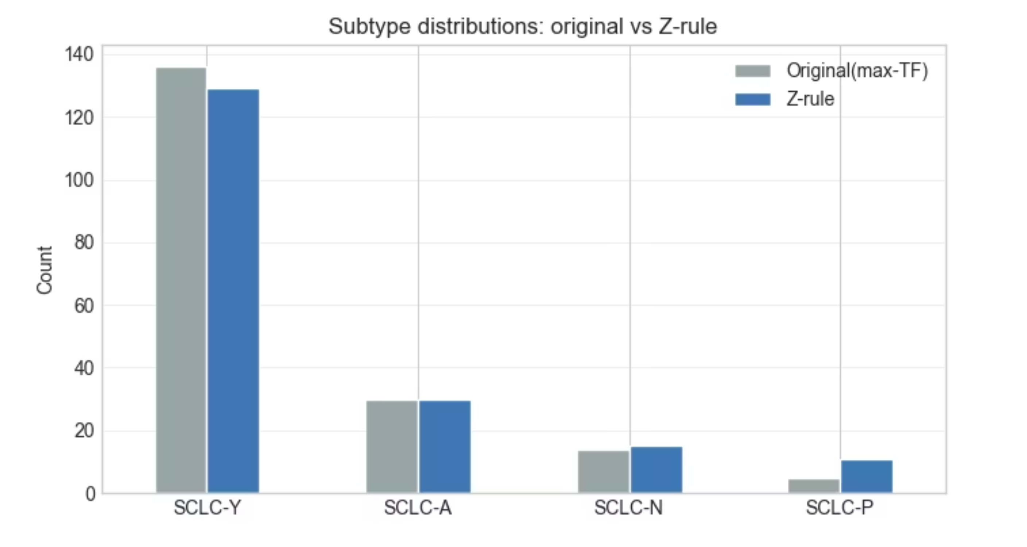
1. TF-Max Rule vs Z-Rule — Assigning SCLC Subtypes
TF-Max Rule (Transcription-Factor Maximum) | Z-Rule (Z-Score Normalized Rule)
• Classifies a sample by the transcription factor (TF) with the highest raw expression among ASCL1, NEUROD1, YAP1, and POU2F3 | • Converts each TF’s expression into a z-score, showing how far above or below average each value is
• Simple and intuitive — whichever gene is most “switched on” defines the subtype | • Chooses the TF with the highest standardized (z-score) as the subtype driver
• Works best when one TF clearly dominates the others | • Removes bias caused by different expression ranges across genes
• Limitation: Sensitive to scale differences between genes | • Limitation: May slightly over-normalize subtle biological differences
Both rules are based on the paper’s principle - “classify by the transcription factor with the greatest relative expression”
The TF-Max Rule mirrors the paper’s raw-expression method, while the Z-Rule is our computational extension for more balanced, scale-independent classification

Slide 6
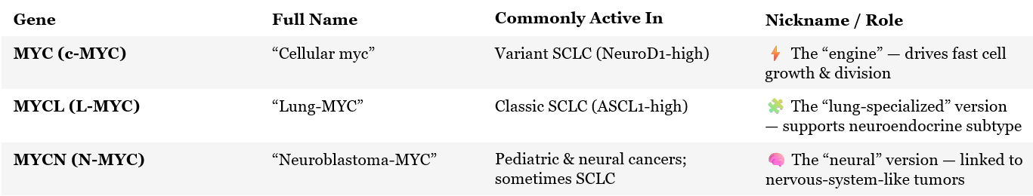
2. Role of the MYC Family in Small-Cell Lung Cancer (SCLC)
The MYC family includes three oncogenes — MYC, MYCL, and MYCN — that regulate cell growth and metabolism.
Frequent amplification observed in SCLC; one of the most consistent genomic findings.
Indicates that MYC genes define the tumor’s biological identity
Notes:
Title: Role of the MYC Family in Small-Cell Lung Cancer (SCLC)
Layout: Three columns — Described, Derived, Therapeutic Link.
Design style: Scientific, clean, professional. Use light backgrounds with gene symbols in bold, and include icons or small visuals for each column.
Column 1 – Described in Paper:
The MYC family includes three oncogenes — MYC, MYCL, and MYCN — that regulate cell growth and metabolism.
Frequent amplification observed in SCLC; one of the most consistent genomic findings.
Distinct subtype associations:
MYCL → ASCL1-high (SCLC-A)
MYC → NEUROD1-high (SCLC-N)
MYCN → rare, neural-like tumors
Indicates that MYC genes define the tumor’s biological identity.
(Add a small heatmap or bar chart image placeholder showing MYCL high in SCLC-A and MYC high in SCLC-N.)
Column 2 – Derived Findings:
Mouse model (GEMM) experiments showed that activating MycT58A pushes tumors to shift from ASCL1-high to NEUROD1-high, proving MYC drives subtype transition.
MYCL marks slower, neuroendocrine subtypes; MYC marks faster, aggressive variants.
Derived a hierarchical model: tumors can evolve from MYCL/ASCL1-high → MYC/NEUROD1-high over time.
(Add a flow arrow graphic: “ASCL1-high (MYCL) → NEUROD1-high (MYC)” with caption “MYC drives evolution.”)
Column 3 – Therapeutic Link:
MYC-high tumors are more sensitive to Aurora Kinase A inhibitors (e.g., alisertib).
Demonstrates MYC as both a diagnostic marker and a predictive biomarker for drug response.
Supports future subtype-specific, MYC-targeted therapy development.
(Add a simple comparison chart showing higher drug response in MYC-high tumors.)
Footer / Citation:Source: Rudin et al., Nature Reviews Cancer (2019) — “Molecular subtypes of small cell lung cancer: a synthesis of human and mouse model data.”

Slide 7
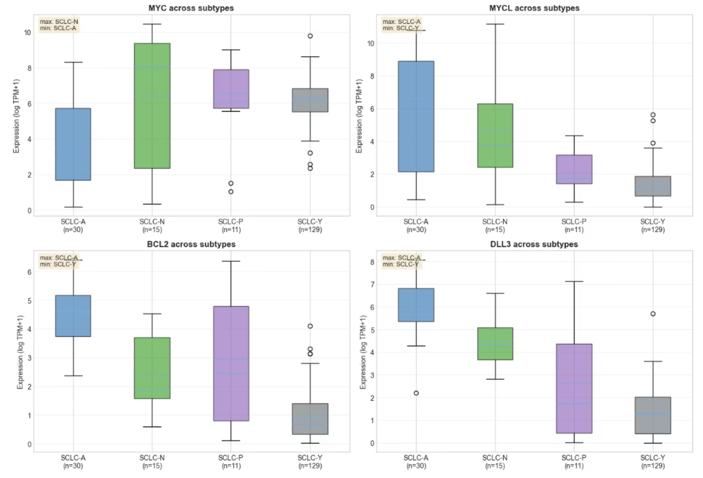
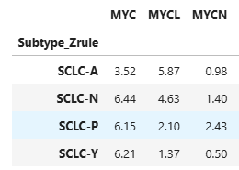
Fig: Differential Gene Expression across SCLC Subtypes MYC Family
Derived Findings:
Demonstrates MYC as both a diagnostic marker and a predictive biomarker for drug response
Supports future subtype-specific, MYC-targeted therapies

Slide 8
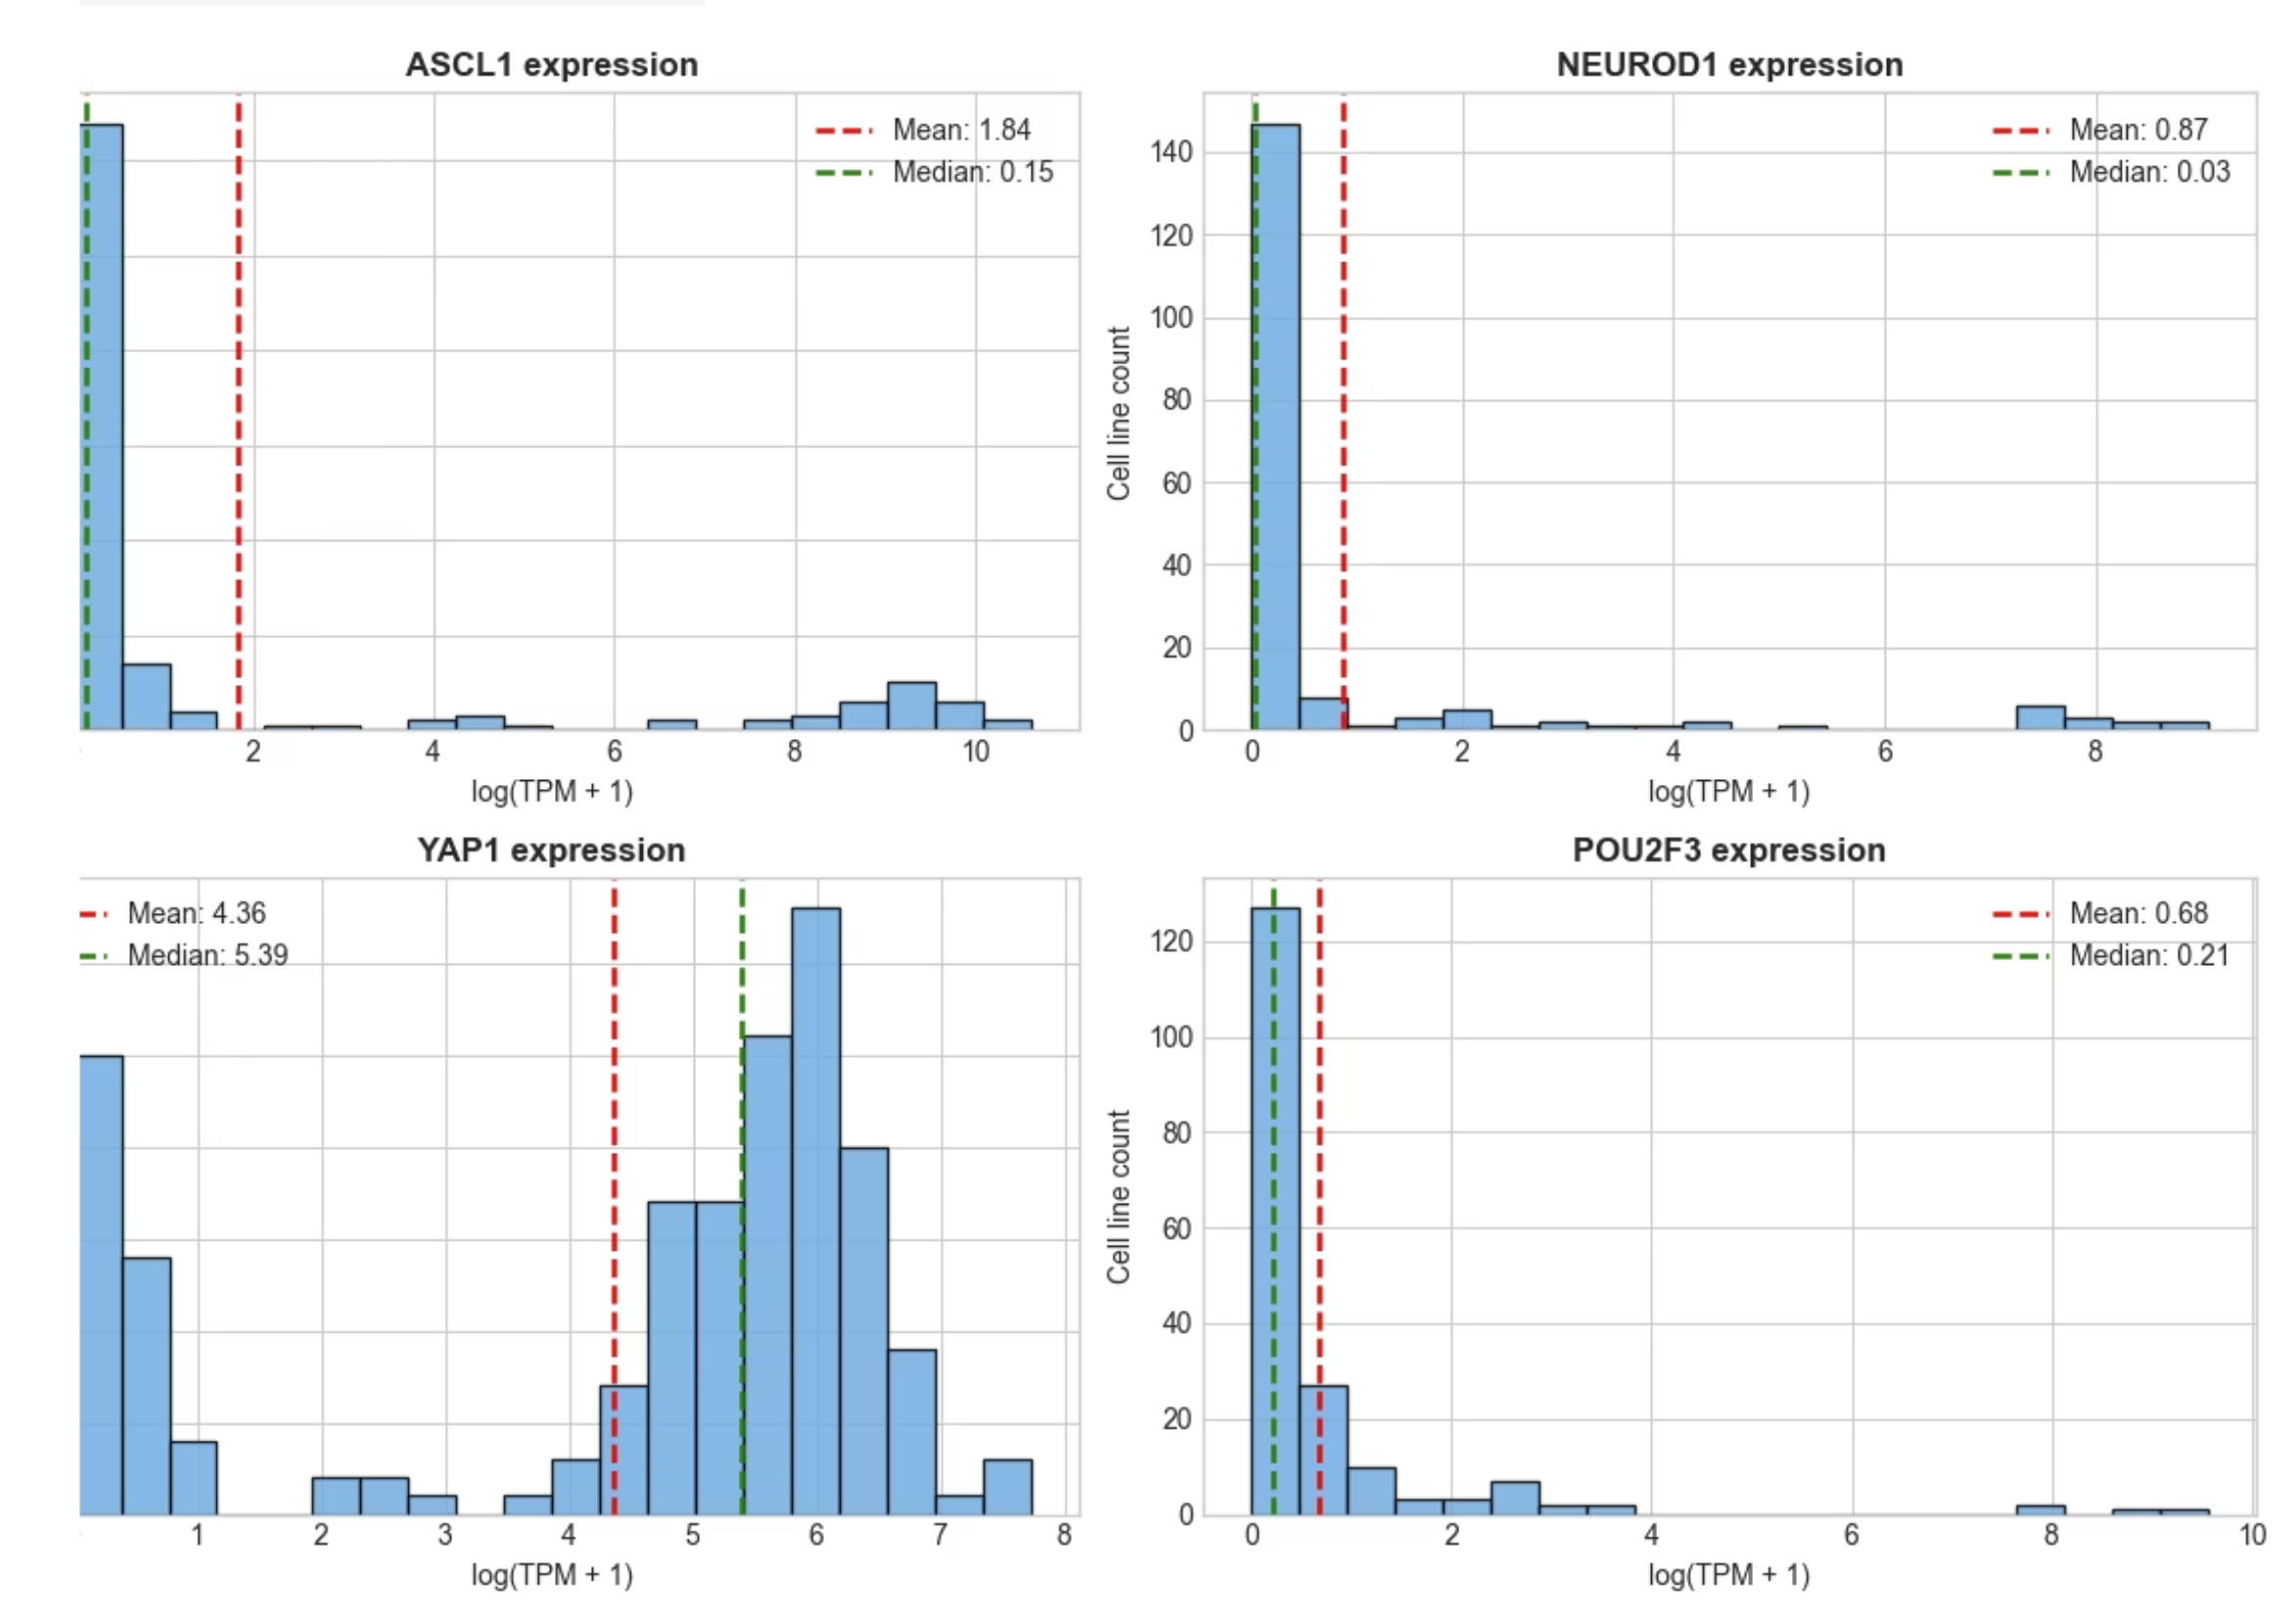
Four Molecular Subtypes : Core Findings
SCLC-A (ASCL1)
1
ASCL1 transcription factor dominant
Markers: BCL2, DLL3 high expression
Neuroendocrine differentiation
SCLC-N (NEUROD1)
2
NEUROD1 transcription factor dominant
Markers: MYC pathway activation
Proliferation-focused biology
SCLC-Y (YAP1)
3
YAP1 transcription factor dominant
Hippo pathway dysregulation
Distinct survival patterns
SCLC-P (POU2F3)
4
POU2F3 transcription factor dominant
Markers: IGF1R high expression
Growth factor signaling prominent
Therapeutic Relevance: Each subtype exhibits distinct vulnerability to targeted therapies, enabling precision oncology approaches.

Slide 9
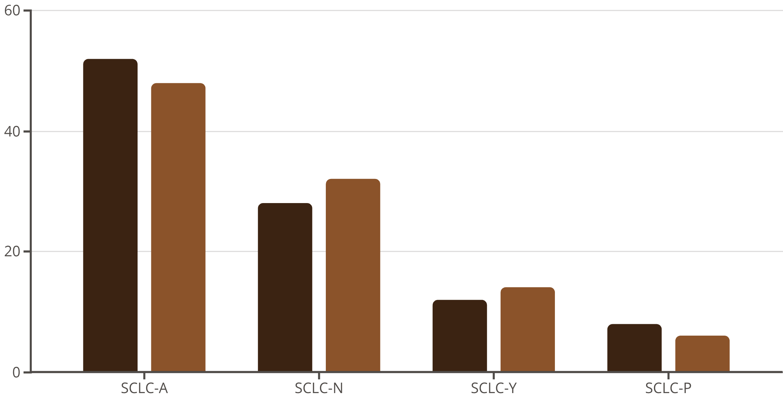
Subtype Proportions: Our Analysis
Comparative analysis of molecular subtype frequencies in our cell line dataset versus published clinical data from Rudin et al. 2019:
Our Dataset (%)
Rudin et al. (%)
Close alignment confirms our implementation successfully captures subtype distributions reported in the original research

Slide 10
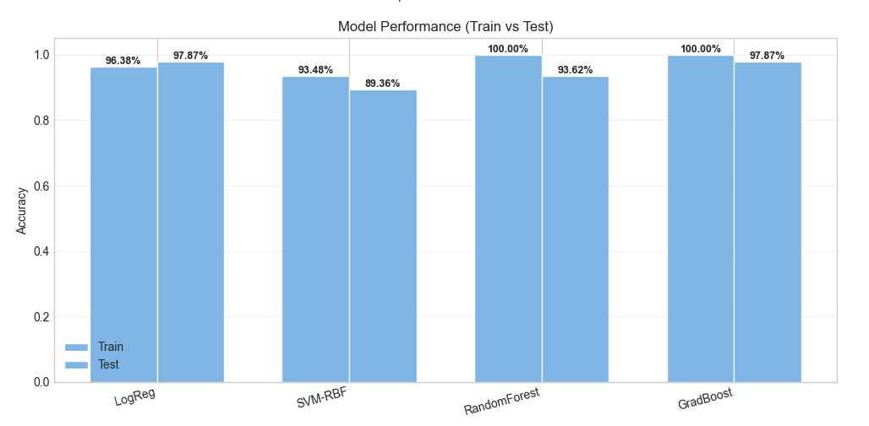
Machine Learning Validation: Subtype Separability
Multiple classification models confirm robust molecular subtype separation:
Gradient Boosting's superior performance (98% Test Accuracy) demonstrates that transcription factor expression patterns encode distinct, predictive subtype signatures, validating Rudin et al.'s biological framework

Slide 11
Conclusion & Future Directions
Key Achievement
Clinical Translation
Future Work
Successfully reproduced Rudin et al.'s four-subtype classification framework computationally, confirming biological validity across independent data.
Demonstrates subtype-specific biology enables precision therapeutics: BCL2/DLL3 inhibitors for SCLC-A, MYC inhibitors for SCLC-N, IGF1R agents for SCLC-P.
Expand to larger patient cohorts, correlate subtypes with drug response, develop clinical diagnostic panel, integrate into treatment decision support systems.
Computational findings mirror Rudin et al.'s biological insights, advancing SCLC from a uniform disease model toward precision oncology implementation

